Slide 1
Terminal Dues 101
PostalVision 2020/5.0
The Ritz Carlton, Pentagon City, Virginia
March 10-11, 2015
James I. Campbell Jr.

Slide 2
Introduction

Slide 3










A post office in the mid-west U.S.A . . .
?!
###!
“49¢ for Old Fred!”
“30¢ for The Inspector!”
“26¢ for
Sr. Villa!”
“15¢ for The Big Fellow”
&^%$#!
“ . . . . . . . . . ..! for La Belle Canadian”

Slide 4
So the Question is . . .
“Why doesn’t the Postal Service charge the same for delivering a foreign letter as it charges for delivering an American letter?”

Slide 5
The Official Answer is . . .
“The Postal Service charges domestic postage for delivering an American letter but must charge terminal dues set by the Universal Postal Union for delivering a foreign letter.”

Slide 6
Topics
What are terminal dues?
How does the Universal Postal Union set terminal dues?
What are current UPU terminal dues rates and how do they affect international commerce?
What TD proposals should the U.S. advance at the 2016 UPU Congress in Istanbul?

Slide 7
1. What are terminal dues?

Slide 8
Terminal dues
Terminal dues are the fees that Posts pay each for the delivery of inbound international “letter post” items.
“Letter post” is a UPU service category for delivery services for documents and packages up to 2 kg (4.4 lb).
Terminals dues are established by agreement in the Universal Postal Union (UPU), an intergovernmental organization.

Slide 9
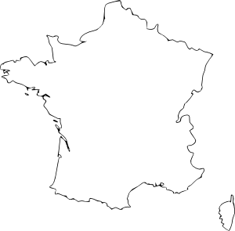
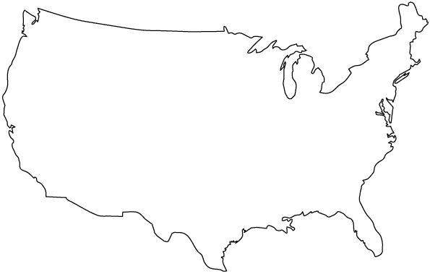
TDs are domestic delivery rates
“Charges for the delivery of inbound international mail, essentially a U.S. domestic mail service, should cover both attributable costs and a fair share of institutional costs.”
-- PRC Commissioner Ruth Goldway, Apr. 2002
Services compensated by Terminal Dues

Slide 10
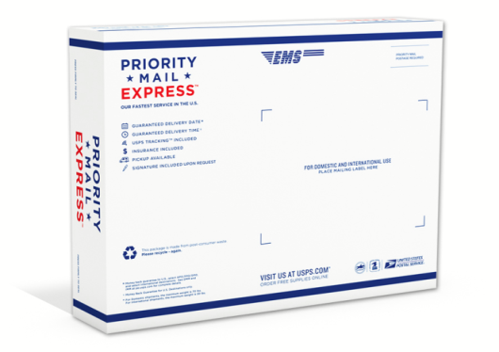


Terminal dues are not limited to letters
The UPU divides the letter post into 3 main sub-categories
Letter (P)
Small letter-sized nvelope. Average 16 g. (0.6 oz)
Flat (G)
Large envelope for documents, reports, etc. Average 115 g. (4.1 oz)
Small packet (E)
Any parcel, box, or rigid envelope weighing up to 2 kg. Average 255 g. (9.0 oz)
Documents
Packages

Slide 11
Terminal dues apply to most USPS int’l services
Market dominant services
  Outbound Single-Piece First-Class Mail International
  Inbound Letter Post
  Inbound Market Dominant Multi-Service Agreements with Foreign Posts
Competitive services
  Inbound Air Parcel Post (at UPU rates)
  Outbound Priority Mail International
  International Priority Airmail (IPA)
  International Surface Air Lift (ISAL)
  Outbound Single-Piece First-Class Package International Service
  More than 140 NSAs

Slide 12
USPS international revenue related to UPU TDs, 2014
MD = Market dominant products; CP = Competitive products
Solid = TD related products; striped = non-TD related products
Outbound
Inbound
Note: Figures are approximate only, based estimates from 2014 RPW and 2012 ACD library references.
TD related totals include NSAs for which TD charges are likely derived from UPU TDs.
Notes:
88% of outbound is subject to TD, almost all competitive; 94% of inbound is subject to TD, about 2/3 is market dominant.

Slide 13
2. How does the UPU set terminal dues?

Slide 14

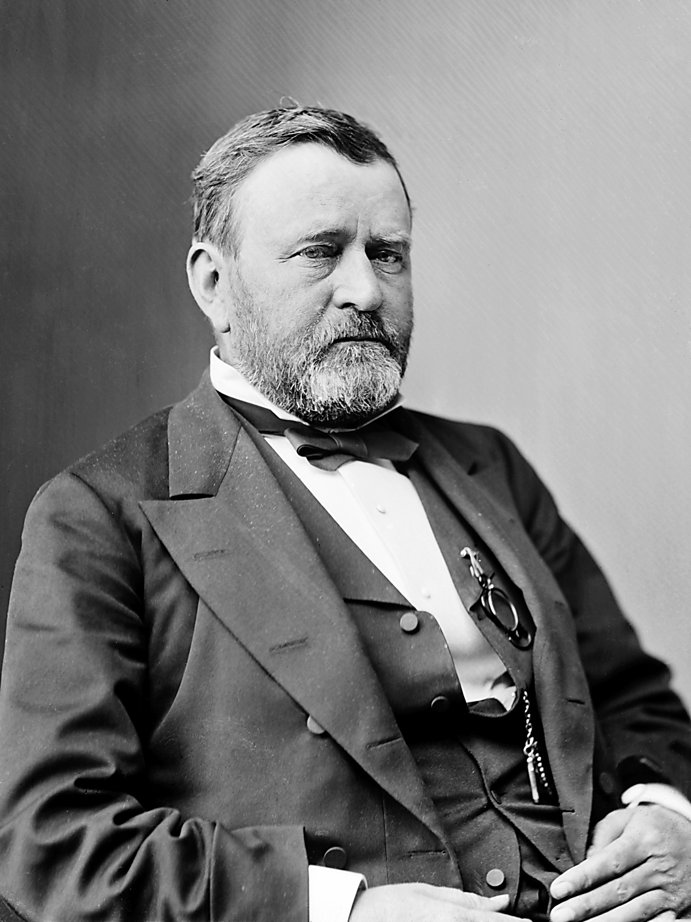
The UPU is an intergovernmental organization
UPU was established by a Convention agreed by 21 countries in 1875.
UPU is the second oldest intergovernmental organization.
In 1875:
  All Posts were government monopolies.
  The Posts conveyed letters, commercial papers, and printed matter.
President Ulysses S. Grant

Slide 15
Postal Operations Council: key actor in UPU TDs
UPU Congress
  All 192 UPU member countries
  Meets every 4 years.
Postal Operations Council (POC)
  40 postal officials elected by Congress.
  Legislative authority
    Adopts Letter Post/Parcel Regulations, about 90% of UPU legal measures.
    Drafts key legal measures for approval by UPU Congress.
  Commercial authority
    Directs all UPU commercial and operational activities.
POC is dominated by large commercial Posts who have served since 1994
1 | Belgium
2 | Brazil
3 | Canada
4 | China
5 | Cuba
6 | Egypt
7 | France
8 | Germany
9 | Great Britain
10 | India
11 | Italy
12 | Japan
13 | Netherlands
14 | New Zealand
15 | Russian Federation
16 | Spain
17 | Switzerland
18 | United States

Slide 16
How terminal dues are set by the UPU
TDs negotiated in the POC
  Four years prior to a UPU Congress, POC officials negotiate a new TD agreement based on updated statistical studies and the relative political power of different groups of Posts.
UPU Congress approves POC proposal
  Practically, review of a POC proposal by a UPU Congress is limited to principles and timetables; revision of specific rates and provisions is not possible.
  UPU Congress adopts TD rates as part of a new Universal Postal Convention.
TDs become effective 18 months later
  New UPU Convention becomes about 18 months after UPU Congress and remains in effect for 4 years.
  POC may have authority to adjust TDs within this period.

Slide 17
3. What are current UPU terminal dues rates and how do they affect international commerce?

Slide 18
2012 Terminal dues agreement
Approved by 2012 Doha Congress of the UPU.
Effective: Jan 1, 2014 to Dec 31, 2017.
3 schedules of TD rates based on the level of economic development of the origin and destination countries.
TD rates are generally uniform for countries within each TD schedule.
TDs rates are unrelated to domestic postage rates.
TDs are quoted in Special Drawing Rights.

Slide 19
Current terminal dues system (2014)
"Transitional Group"
"Target Group"
Max rate for typical kg of int'l letter post (IPK=10.88)
5.49 / 5.89 SDR*
3.91 / 4.20 SDR*
3.80 / 4.16 SDR*
* Second rate applies if annual bilateral flow is less than 75 tonnes.
Names of groups are unofficial.
Relative volumes are rough estimates by J. Campbell.

Slide 20
TDs v. equiv. domestic postage, 2014 - Letter Post
What the average industrialized country Post charged for delivery of an average kg of inbound international mail in 2014 compared to equivalent domestic postage (estimated)
Source: Estimates by James I. Campbell Jr. Equiv. domestic postage based on 70 percent of prioirty domestic postage rates.
Notes:
Discounts: 46% 72% 65%

Slide 21
TDs v. equiv. domestic postage, 2014 - Small Packets
What the average industrialized country Post charged for delivery of an average kg of inbound international mail in 2014 compared to equivalent domestic postage (estimated)
Source: Estimates by James I. Campbell Jr. Equiv. domestic postage based on 70 percent of priority domestic postage rates.
Notes:
Discounts: 57% 78% 75%

Slide 22




"E-commerce posts" are growing rapidly
E-commerce small packets from China to the US increased 182% from from 2011 to 2012 (9.5 to 26.8 mil).
Singapore Post international mail revenue increased 53% from FY 2012 to FY 2014, mostly due to e-commerce
Alibaba bought 10% of Singapore Post in May 2014.

Slide 23
USPS losses on delivery from “developing countries”
USPS OIG Report on Inbound Chinese ePackets, Feb. 25, 2014
Year | Volume (mil) | % increase | Revenue ($ mil) | Loss ($ mil)
2011 | 9.5 |  | $ 6.0 | $ 9.6
2012 | 25.3 | 182% | $26.8 | $29.4
Washington Post, Sep 12, 2014
The Postal Service is losing millions a year to help you buy cheap stuff from China

Slide 24
Six types of distortions created by current terminal dues
Effects of terminal dues (CE)
Distortion of competition
  1) for last-mile handling of cross-border mail
  2) for first-mile handling of cross-border mail
Distortion of global mail and trade flows in terms of distorted demand for
  3) Delivery services within vs. outside the scope of terminal dues
  4) Domestic vs. cross-border delivery
  5) Cross-border delivery from target vs. transition country origin
  6) Transfers between delivery operators leading to spill-over effects

Slide 25
4. What TD proposals should the U.S. advance at the 2016 UPU Congress in Istanbul?

Slide 26
U.S. policy re international postal services
"To promote and encourage communications between peoples by efficient operation of international postal services and other international delivery services for cultural, social, and economic purposes."
"To promote and encourage unrestricted and undistorted competition . . ., except where provision of such services by private companies may be prohibited by law of the United States."
"To promote and encourage a clear distinction between governmental and operational responsibilities . . . by intergovernmental organizations of which the United States is a member.“

Slide 27
U.S. laws re UPU TD agreements
Before concluding a UPU agreement, the Postal Regulatory is required to prepare “views” on whether a rate or classification relating to an international market dominant product is “consistent with the standards and criteria established by the Commission” for similar domestic products under Title 39.
  The Secretary must ensure that the UPU agreement is consistent the views of the PRC except to the extent the determines that there are overriding foreign policy or national security interests.
No cross subsidy from market dominant to competitive products.
No undue or unreasonable preference or discrimination.
Agreements must comply with U.S. antitrust law (excluding provisions re monopoly products).

Slide 28
Limits on U.S. international postal agreements
“The Secretary of State may not conclude any UPU agreement that would “grant an undue or unreasonable preference to the Postal Service, a private provider of international postal or delivery services, or any other person” with respect to any competitive product.

Slide 29

Interests of U.S. service providers
Est. shares by revenue, 2008
Total revenue = $ 31 bil
Key
Red = Private company
Blue = Public DO
Stripe = Privatized DO
Source: UPU, Adrenale Report (2010). Market includes services for documents and packages < 2 kg only.
Notes:
When Posts operate outside their national markets, they act a commercial businesses. Letter business is declining more rapidly. Governments have less control over market developments.

Slide 30
Relative exposure of U.S. operators

Slide 31


Interests of U.S. users
U.S. merchants are harmed by subsidized delivery of foreign e-commerce products.
U.S. direct marketers may be aided by subsidies for USPS outbound products if subsidies reduce prices.
U.S. market dominant mailers are harmed if low inbound TDs subsidize low-priced outbound USPS competitive products.
U.S. commerce has strong interest in free trade in services.

Slide 32
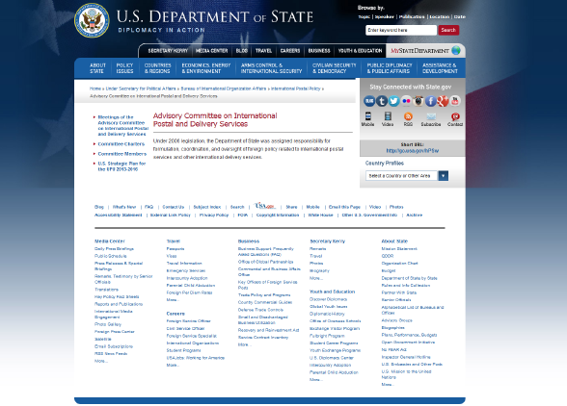
Dept of State: Advisory Committee on IPODS
http://www.state.gov/p/io/ipp/c25478.htm

Slide 33
Proposal by FedEx/UPS/JC (Sep 2014)
Postal shipments between industrialized countries
  Terminal dues should be consistent with the postal and antitrust laws governing domestic postal services.
Postal shipment of very large quantities of e-commerce packages from developing countries.
  The destination country have the option to charge terminal dues that are consistent with the postal and antitrust laws governing domestic postal services.
Other postal shipments to/from/between developing countries
  UPU should develop plan in the next 4 years for introducing terminal dues for all countries that are (A) consistent with the postal and antitrust laws governing domestic postal services and (B) maintain reasonable financial assistance for needy developing countries.

Slide 34

Proposal by U.S. Postal Service

